Slide 1

Analytics. What is it? Why is it Important?
Mike Fry, Ph.D.
Professor and Department Head
Operations, Business Analytics & Information Systems

Slide 2
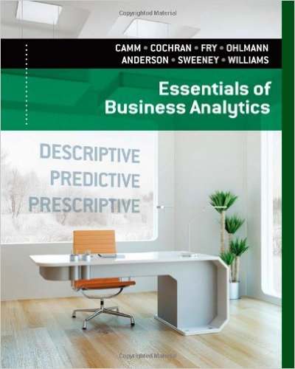
Who am I?
Professor & Department Head
  Operations, Business Analytics & Information Systems
  Center for Business Analytics
Research
  Supply chain optimization, public-policy operations, decision making
Consulting Experience
  Dell, Starbucks, Coleman, P&G, Cincinnati Zoo, US EPA, Cincinnati Bengals, Ohio Election Commission, United Way, Great American Insurance

Slide 3
Analytics
Analytics is the scientific process of transforming data into insight for making better decisions.

Slide 4
Analytics Overview
Descriptive
Tells what is
Predictive
Estimate future outcomes
Prescriptive
Gives a course of action
Importance
Help make better decisions
Automated vs. assisted decision making
“What if” analysis
Data visualization, descriptive statistics

Slide 5

Why Analytics?
What makes a decision difficult?
Notes:
Uncertainty, lots of alternatives, politics, etc.

Slide 6

Why Analytics?
Let’s have a quiz!

Slide 7

Why Analytics?
How good are you at estimating your own ability to measure uncertainty?

Slide 8

It’s Not Just You…
93% of Americans think they have above-average driving skills
87% of MBA students at Stanford University rated their academic performance as above the median
68% of teachers in a survey of faculty at the University of Nebraska rated themselves in the top 25% for teaching ability
“Cognitive Bias”

Slide 9

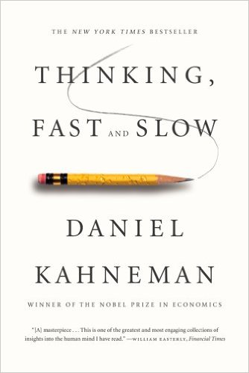
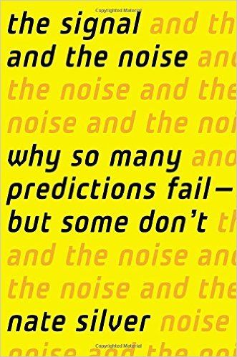
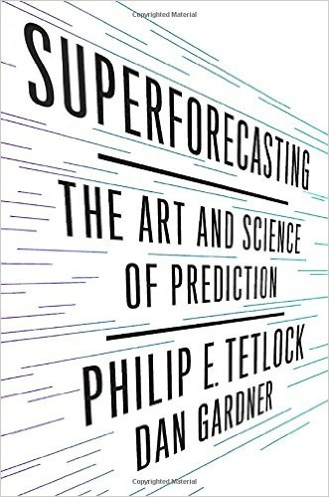
Limitations of Human Analysis
“I decide with my gut!” ???
    n = 1
Thinking “Fast” vs. Thinking “Slow”

Slide 10
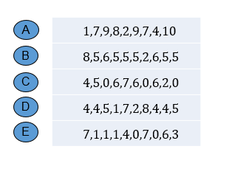
Which of the following is a random string of 10 digits?

Slide 11

Signal vs. Noise
“Patternicity”
Type I Error: I think it’s a predator, but it’s the wind
  I run away. Look silly.
Type II Error: I think it’s the wind, but it’s a predator
  I die.

Slide 12
Why does this matter?
Predictive Analytics uses data + models to (help) remove these biases!
  Based on statistics, not “gut”
But… models just provide another input into decision making

Slide 13


Whistler Blackcomb
One of top ski areas in the world
  815,000 visitors in winter in 2008-2009 (Nov 1 – Apr 30)
  Avg # per day in winter: 12,638; summer, 12,550.
Whistler Blackcomb Ski and Snowboard School offers over 50 lesson types with more than 1200 instructors
How many ski instructors needed on particular day?
Notes:
Affected by recession and lack of snow
Sea-to-sky highway improvements not finished until 2009

Slide 14
Whistler Blackcomb Demand Forecasting
Some possible factors:
Day of Week
Holiday
Snow Amount
Exchange Rates
Day of season (early, peak)
Demand this day last season (lag)

Slide 15
Predictive Model: Multiple Regression
Model:
Demand = 16.1 – 0.02*(Day of Season) – 0.016*(Demand This Day Last Season) + 1.04*Pre-Bookings + 0.08*Snow + 7.68*(UK Exchange) – 21.92*(US Exchange) + 0.27*Mon – 1.4*Tue – 1.86*Thur – 0.4*Fri + 0.03*Sat + 0.64*Sun
Model provides estimate of demand for ski school with high-degree of accuracy
BUT… that is not most valuable output of model

Slide 16
Regression Residual Analysis
Residual = Actual demand - our model’s predicted demand
How wrong were we in the past?
Residual Analysis
Estimate confidence of future predictions

Slide 17
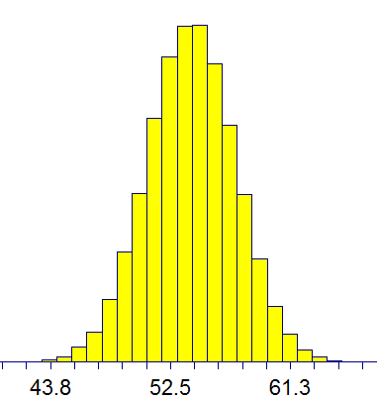
Uncertainty in Predicted Amount
Actual Demand | Predicted Demand | Residual = Actual Demand - Predicted Demand
16 | 10 | 6
11 | 11 | 0
9 | 8 | 1
20 | 16 | 4
28 | 20 | 9
16 | 15 | 1
8 | 7 | 1
4 | 6 | -2
5 | 7 | -2
-9 -2 +2 +9
95% certain that actual demand
will be between 48 and 60 students.
Most likely value = 54
BUT… could be more or less

Slide 18

Benefits of Analytics
Mitigates Human Bias
Reveals Unexpected Correlations
Mitigates cognitive biases
Too much data to be manually analyzed
Provides Information on Uncertainty
Errors in model predictions vs. actual results are valuable
Reduces cognitive biases
Less susceptible to “fooled by randomness”

Slide 19
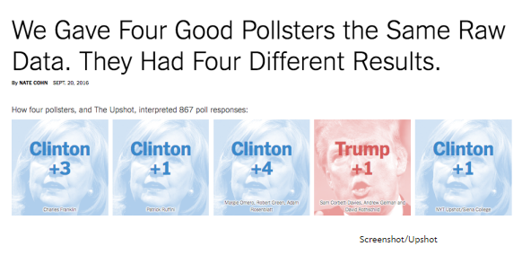
Analytical Models Still Susceptible to Patternicity
Exposure to Substance “Y”
Incidence of Disease “X”

Slide 20
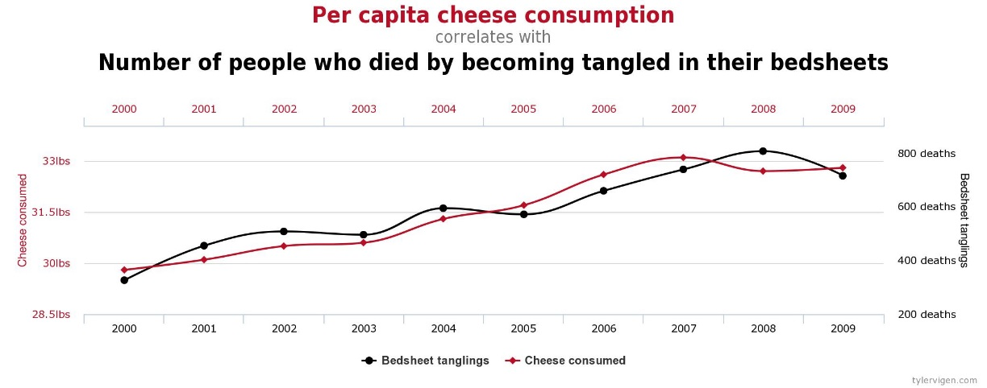
Cheese and Death By Bedsheets
Regression Equation:
People Dying by Bedsheets
= -3037.5 + 115.11*(Per Capita Cheese Consumption)
R² = 0.89
p-value for Cheese Consumption
= .00014

Slide 21
Limitations of Predictive Analytics?
Provides Inputs Not Answers
More Data is Not Always the Answer
Can actually lead to additional statistical challenges
Decision maker must combine this information
Predictive models provide additional information to the decision maker
Spurious relationships

Slide 22
Analytics Takeaways
Can Lead to New Insights
Data is Not Information
Analytics helps translate data into insights
Mitigates cognitive and other human-subject biases
Must be combined with subject-matter expertise and other inputs to reach best decision
Powerful Methods to Automate Predictive Tasks
Great for “routine” tasks
Provides inputs, not decisions
More data is not always better
Provides information on actual uncertainty of predictions

Slide 23
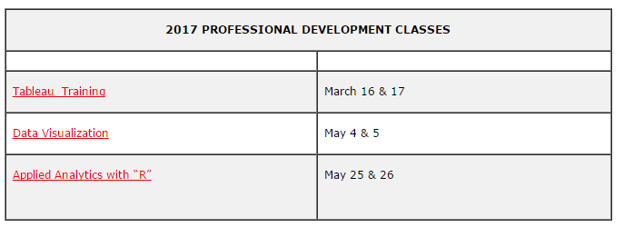
For Actual Analytics Training…
Center for Business Analytics Professional Training
Data Science and Data Analytics Certificates
MS in Business Analytics

Slide 24
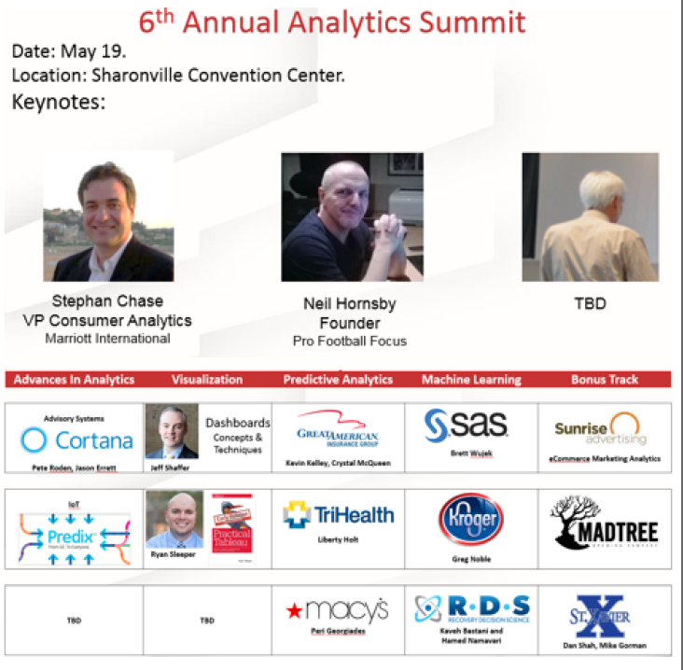
May 19: Analytics Summit 2017

