Slide 1
A Walk in the Cloud
Considerations for Cloud Computing
Patrick Cunningham, CISM, FAI
November 8, 2016

Slide 2
Acknowledgements
Elements of this presentation are taken from the following:
  “A Walk in the Cloud”, Information Management, January / February, 2009.
  “IT’s Responsibility for Security, Compliance in the Cloud”, ARMA International Hot Topics, October, 2010.
  “Another Walk in the Cloud”, Information Management, September / October, 2016.

Slide 3
Objectives
Understand what the “cloud” encompasses.
Understand differences and similarities to other types of outsourcing.
Identify and articulate key benefits and risks in this space.

Slide 4
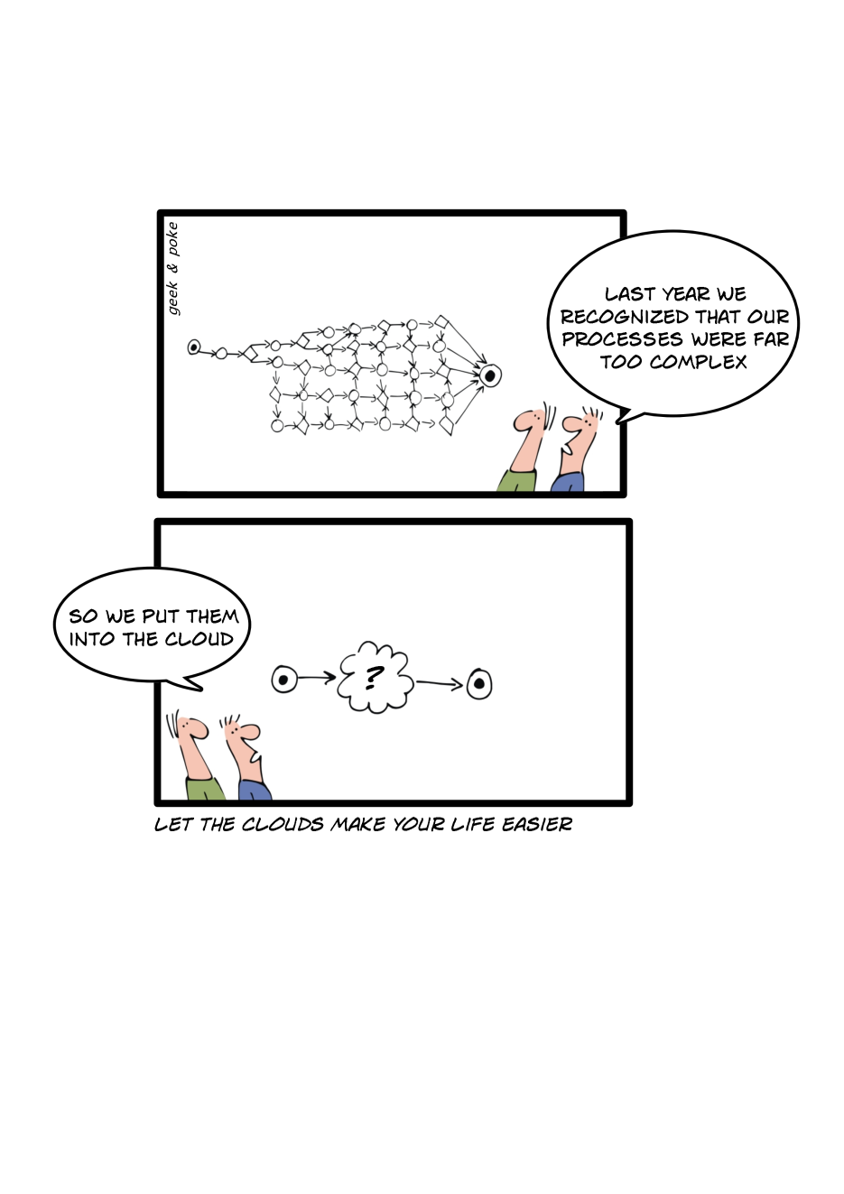
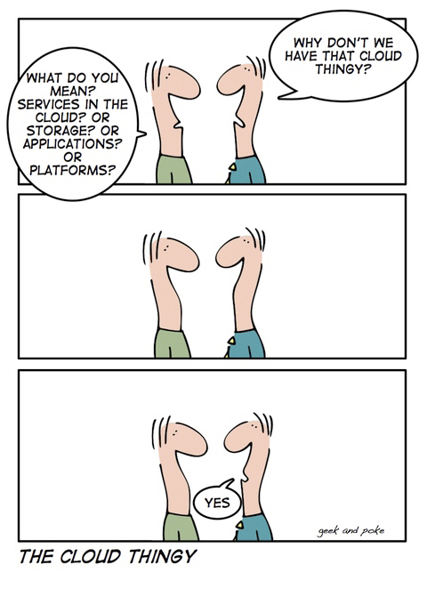
Web 2.0 and The “Cloud”
http://geekandpoke.typepad.com/geekandpoke/

Slide 5
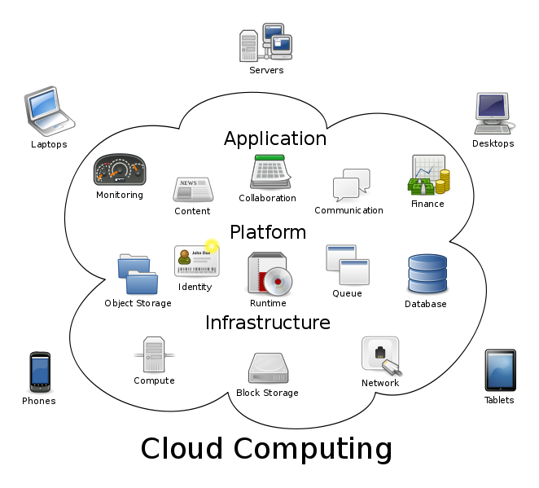
Cloud Computing in a Graphic

Slide 6
NIST Definition of Cloud
Cloud computing is a model for enabling ubiquitous, convenient, on-demand network access to a shared pool of configurable computing resources (e.g., networks, servers, storage, applications, and services) that can be rapidly provisioned and released with minimal management effort or service provider interaction. This cloud model promotes availability and is composed of five essential characteristics, three service models, and four deployment models.
http://csrc.nist.gov/publications/drafts/800-145/Draft-SP-800-145_cloud-definition.pdf

Slide 7
NIST Definition
Essential Characteristics
  On-demand self-service.
  Broad network access.
  Resource pooling.
  Rapid elasticity.
  Measured Service.
Service Models
  Cloud Software as a Service (SaaS).
  Cloud Platform as a Service (PaaS).
  Cloud Infrastructure as a Service (IaaS).
Deployment Models
  Private cloud.
  Community cloud.
  Public cloud.
  Hybrid cloud.

Slide 8
*aaS
SaaS – Software as a Service
  Office 365. G-Suite
SaaS – Storage as a Service
  Dropbox, Box.com
IaaS – Infrastructure as a Service
  Web hosting / Amazon Web Services
PaaS – Platform as a Service
  End to end computing services
CaaS – Communication as a Service
  DialPad, Skype

Slide 9
Alignment with Outsourcing
IT Outsourcing
  Vendor may own the infrastructure and co-mingle information with other clients
  Vendor may determine which applications will be supported
Records Center Outsourcing
  Records boxes generally co-mingled
  Pay for consumption model
HR and Benefits Outsourcing
  Ability to scale to peak (annual enrollment)

Slide 10
BENEFITS

Slide 11
Key Benefits
Cost reduction
  Low barriers to entry
  Low capital expense
  Scalability to need
Collaboration
Simplicity
Accessibility
  Device independence
  Location independence

Slide 12
Cost Reduction
Reduced capital expense and operating costs
  Cost moved from capex to opex
Reduced cost for application and OS upgrades
Economies of scale

Slide 13
Resilience and Uptime
Large providers have mandate to provide uptime and can easily deal with outages
Large providers leverage multiple data centers and architectures that limit data loss.

Slide 14
Elasticity
With many providers it is easy to add CPU power and storage capacity to meet peak or temporary computing needs
When no longer needed, excess capacity can be “spun down” and cost eliminated
Eliminates need to acquire and maintain capacity for cyclical demand

Slide 15
Collaboration
Many providers enable real time and simultaneous collaboration on documents
Eliminates the need to reconcile multiple versions
Allows updates continuously, even as a document is being presented
Other tools allow easy video conferencing and sharing of documents

Slide 16

And Now, the Risks
RISKS

Slide 17
Key Risks
Security
  It’s on the Internet and you likely use a browser to get to it
Resiliency, Availability, Accessibility
  Is it broken?
  Is my connection broken?
E-discovery
  Exactly how does this work?
  With shared storage, will someone else’s data be exposed with mine?

Slide 18
Risks
E-discovery and the Law
  The law is probably ten years behind technology.
  Legal expectations about ESI make assumptions that were true ten years ago
  Jurisdiction is an increasingly critical issue – where is the information stored and where does it go?
  See: Microsoft Corporation v. United States of America, (also referred to as: In re Warrant to Search a Certain Email Account Controlled & Maintained by Microsoft Corp. -- 15 F. Supp. 3d 466 (S.D.N.Y. 2014)).

Slide 19
Risks
Computer Forensics
  Can we obtain uncontaminated data?
  How do we maintain chain of custody?
  How do we show what has been deleted?
  Are the logs good enough?
Records Management
  Can retention schedules be applied?
  Is search and storage more important than disposition?

Slide 20
Risks
Data Privacy
  Where is the data?
  Who has access to it?
  How do we dispose of data no longer needed?
  How do we disclose transfers and processing?
  Is the data encrypted?
Infrastructure / Application Duplication
  Some infrastructure and applications may need to be maintained for power users and for tethered users

Slide 21
Where’s My Data?
Jim-Bob’s E-discovery Suite
  BigLawFirm contracted with Jim-Bob.
  Jim-Bob contracted with Billy-Joe for CPU and disk space, but Billy-Joe had contracted with the South African "cloud" to provide that CPU and disk.
  The South African cloud was owned by a Japanese telecom that was being acquired by a Chinese company.
  Both Jim-Bob and Billy-Joe had click through agreements with the next hop in the chain and neither could provide copies of what they agreed to.

Slide 22
Risks
Who Owns the Data?
  The employee
  The employer
  The service provider
Migration
  Negotiating the divorce before the marriage
  How do you change providers?
  How do you get all of your data back?

Slide 23
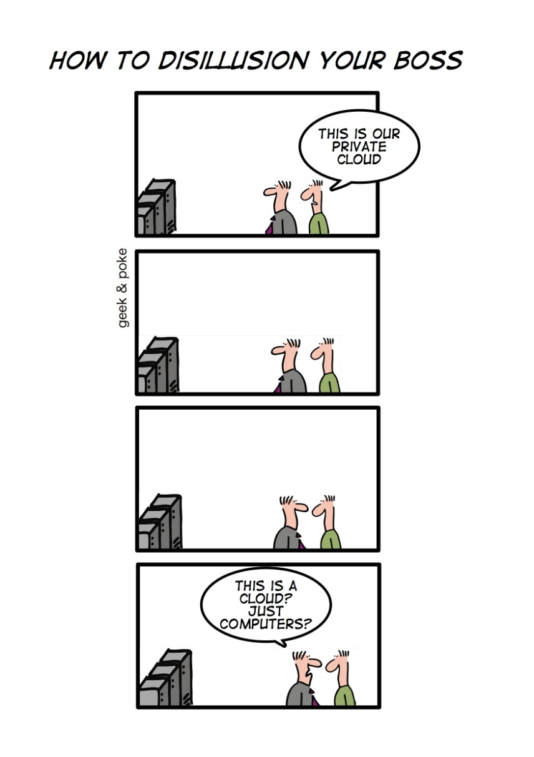
Partly Cloudy
Private clouds
  Outsourced model where a single organization’s data and applications are maintained on dedicated infrastructure
  Resolves many issues, but maintains the benefit of the cloud model
http://geekandpoke.typepad.com/geekandpoke/2010/07/how-to-disillusion-your-boss.html

Slide 24
Risk Mitigation
Legal
  Contractual language
  Service Level Agreements
Resiliency
  Pre-planning
  Multiple paths to connect
Documentation
  Understand the environment
  Prepare responses for “Meet and Confer”

Slide 25
Risk Mitigation
Policy
  Ensure that your employees have limits and the limits are enforced – don’t allow employees to work outside IT and Law to develop cloud solutions
Encryption
  Sensitive information must be encrypted in transit and at rest – ideally all data should be encrypted at rest
Limit / Monitor Remote Access and Downloads

Slide 26
What if They Don’t Pay Their Bills?
Cloud-based flow charting
  A fraction of the cost of Visio, provides some nice bells and whistles, and leverages Amazon Web Services for storage and computing power.
  "Great!" some people thought. "We use Amazon as well". Yeah, but. The flow charting company can't put our data in our Amazon space and our agreement with Amazon does not supersede anyone else's agreements with Amazon, even when it is our data.
  If the flow charting company goes out of business or fails to pay Amazon, our data could be at risk.

Slide 27
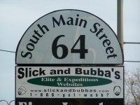
Risk Mitigation
Sourcing the cloud – a collaboration
  Business identifies an opportunity
  Business creates requirements
  IT evaluates solutions and risks
  Procurement evaluates vendors, performs initial negotiation
  InfoSec reviews security risks, grades appropriately
  Law negotiates contract

Slide 28
Saving Email as an Object
Email to PDF
  An end-user had a requirement to export his email from Google Mail as individual email objects (in Microsoft Outlook terms, as a .msg format) for retention in an external record-keeping system.
  The user identified a Google Chrome extension that would convert the email and any attachment to PDF format.
  The tool was written by a developer in India as a hobby and hadn’t been updated in over a year. The tool also required Google permissions to globally access all of the user’s Google Mail environment and make changes.
  The tool would convert email messages by rule and delete them from the message repository. There was no license agreement or data privacy statement made by the tool’s developer.

Slide 29

Patrick Cunningham, CISM, FAI
p1cunnin@gmail.com

