Slide 1
Managing Compliance Early: System Development
Randy Moeller
Records & Information Governance
P&G

Slide 2
iRisk Application
What does it do
Who is involved
Review process
Records & Information Governance review
Links to other processes
Challenges (nothing’s perfect)

Slide 3
What Does it Do
Review of IT initiatives by 15 compliance groups
  .net application, .sql database
Complete 14 questions; results in a score by each group
States a consult or self-assess
Documents compliance via forms and/or notes

Slide 4
Who is Involved
15 Compliance Groups Represented
  Business & IT Continuity
  Employee Relations
  Enterprise Architecture
  Global Security
  Health, Safety & Environment
  Information Security
  Labor Relations
  Legal – Digital Privacy & Commerce
  Legal – Intellectual Property
  Payment Card Industry
  Privacy
  Records & Information Governance
  Regulatory Computer Validation
  Third Party Risk Assessment
  Vendor Governance

Slide 5
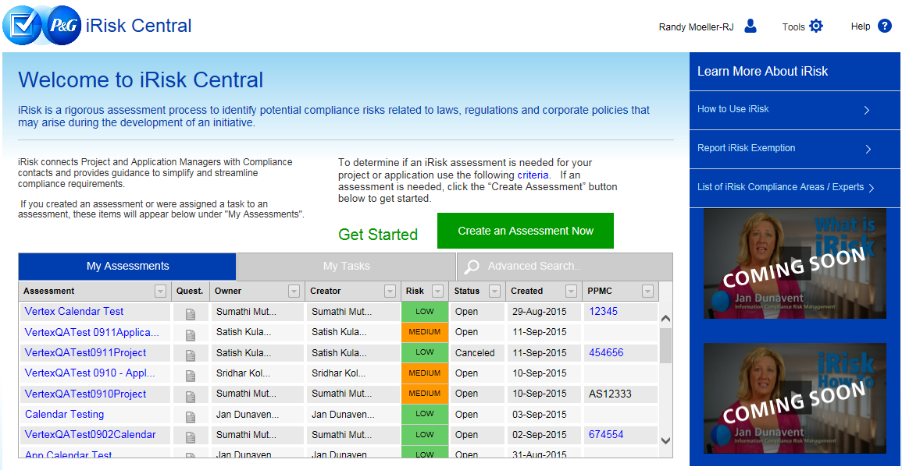
Review Process

Slide 6
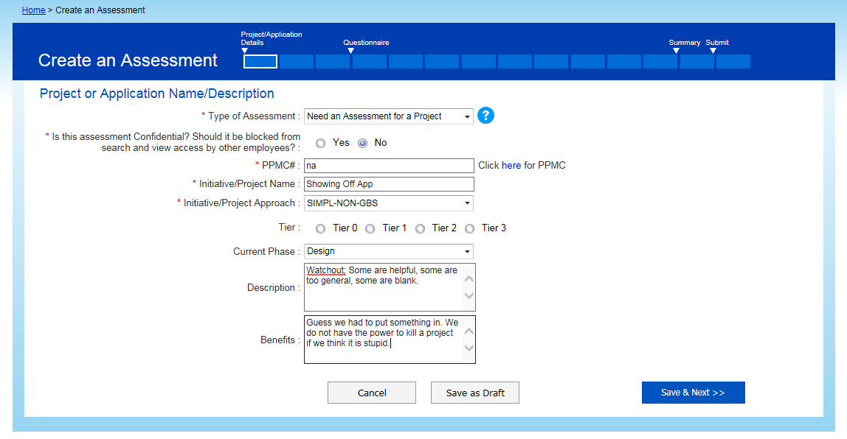
Details

Slide 7
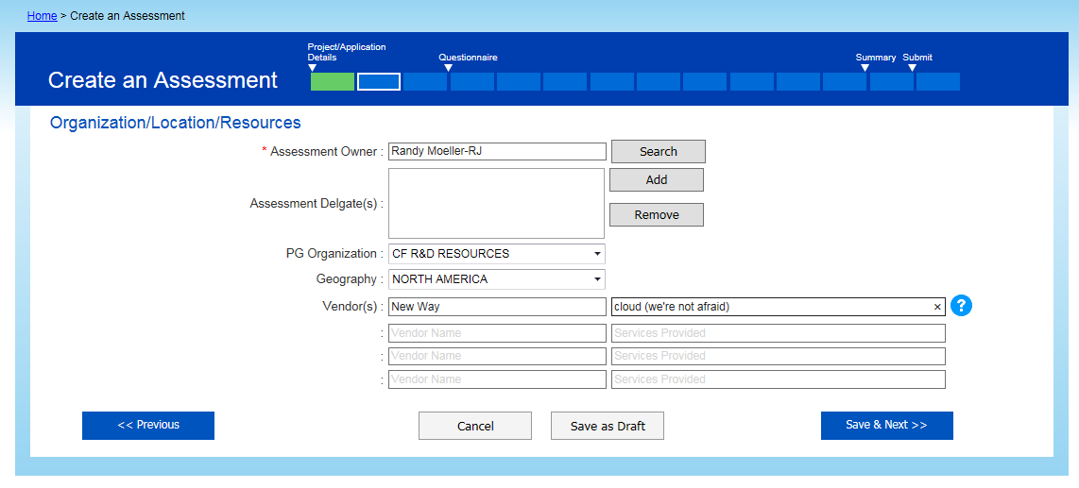
Details

Slide 8
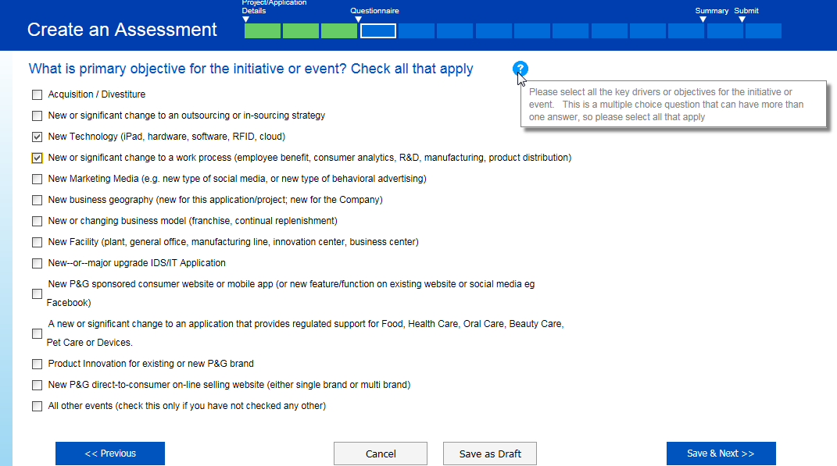
Multiple Choices

Slide 9
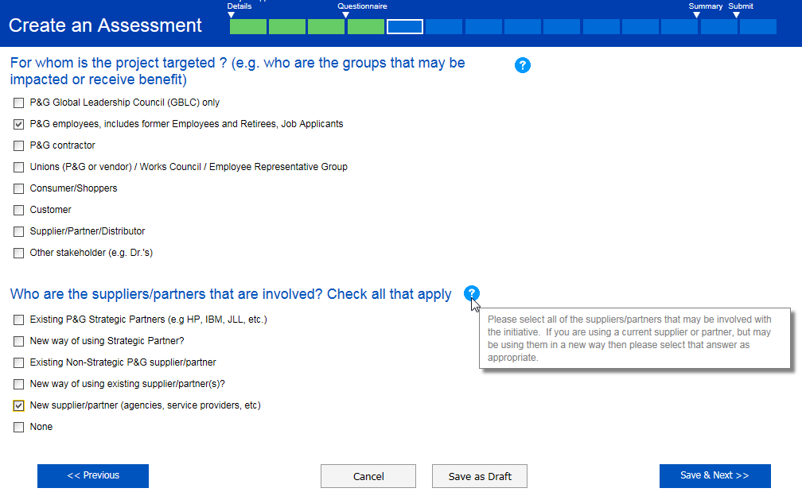
Each Selection Scored

Slide 10
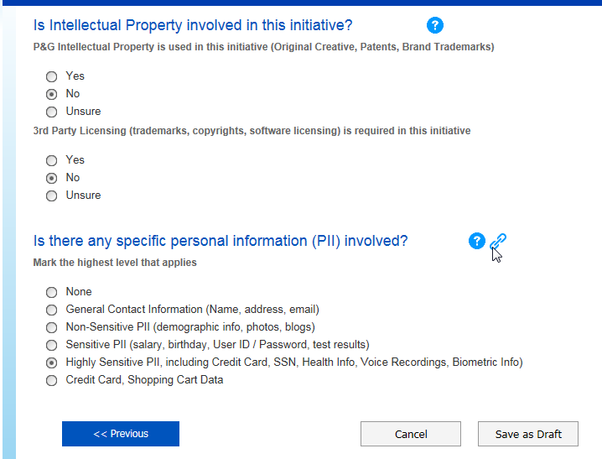
Links Where Needed

Slide 11
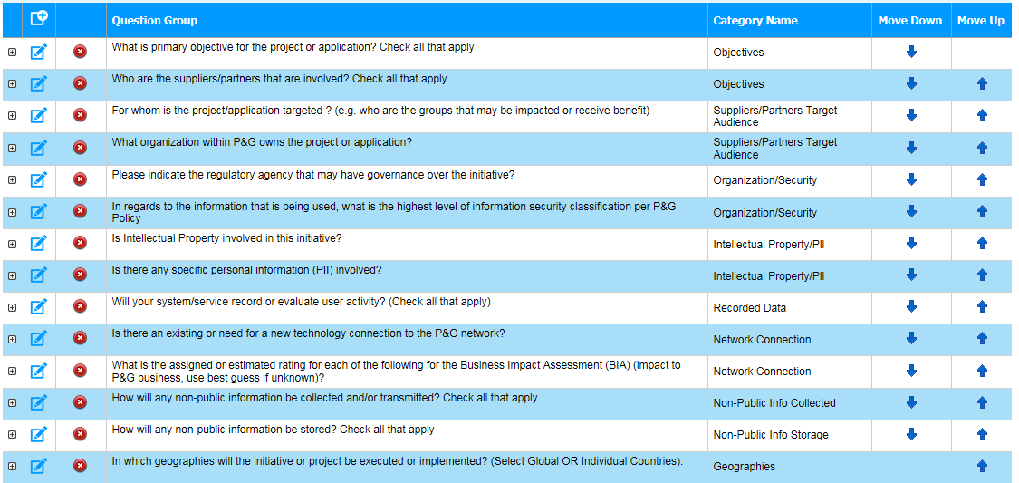
Question List

Slide 12
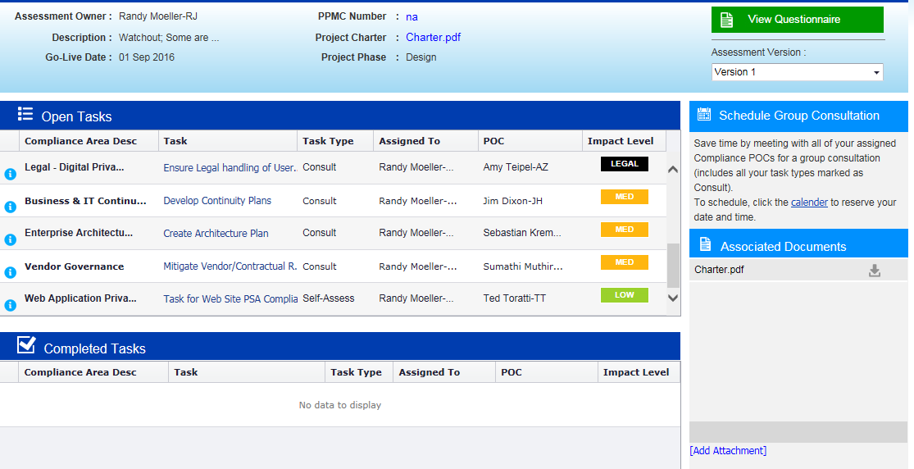
Results

Slide 13
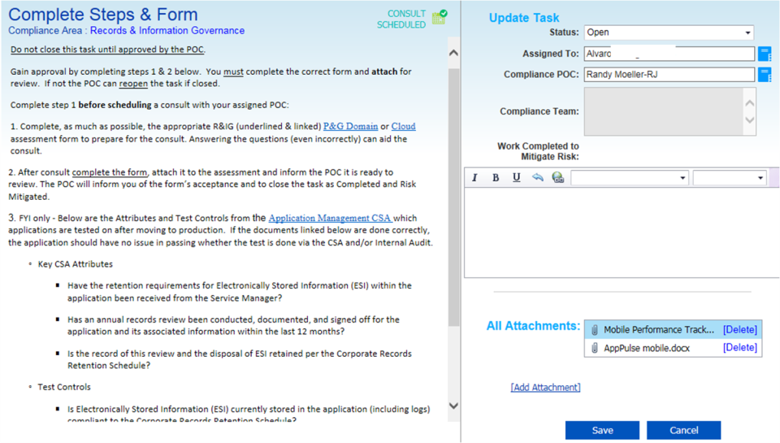
Task Details

Slide 14
R&IG Compliance Document

Slide 15
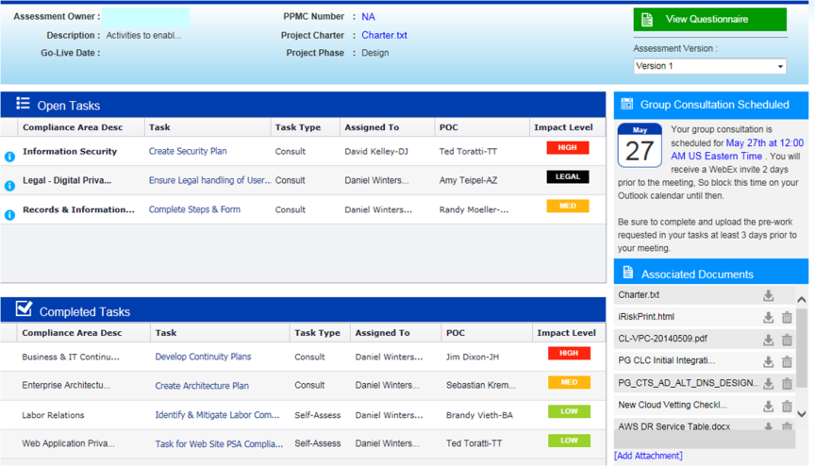
Completing Tasks

Slide 16
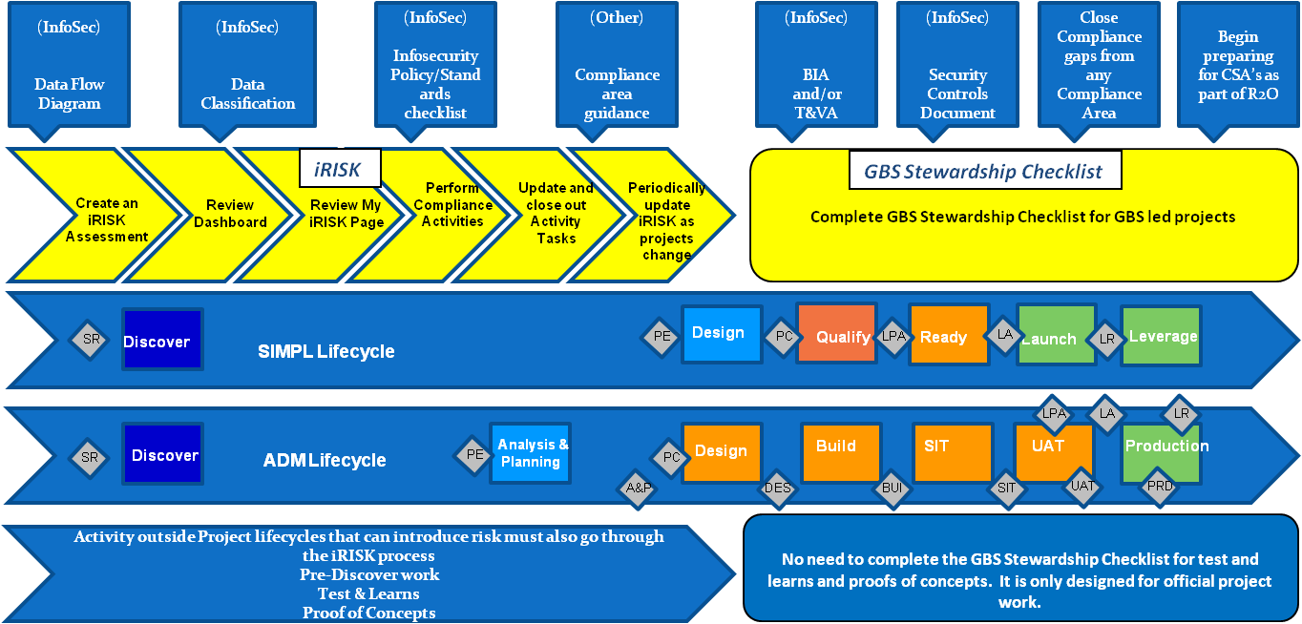
Process Links

Slide 17
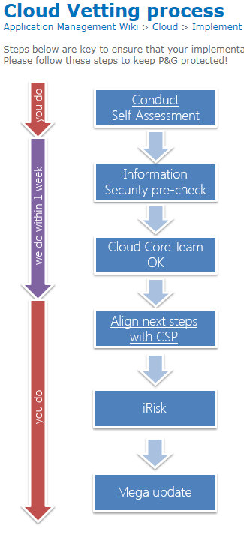
Cloud Process
Cloud Security Alliance
  Matrix
Skyhigh Network
  Cloud provider assessments

Slide 18
JAS Results
Be careful what you wish for…
Row Labels | Consult | Self-Assess | (blank) | Grand Total
Records & Information Governance | 100 | 41 |  | 141
Information Security | 123 | 16 |  | 139
Business & IT Continuity | 64 | 70 |  | 134
Labor Relations | 88 | 42 |  | 130
Enterprise Architecture | 29 | 83 |  | 112
Employee Relations | 94 | 7 |  | 101
Privacy | 59 | 34 |  | 93
Legal - Digital Privacy & Commerce | 81 |  |  | 81
Vendor Governance | 24 | 37 |  | 61
Legal - Intellectual Property | 20 | 26 |  | 46
(blank) |  |  | 35 | 35
Third Party Risk Assessment | 27 |  |  | 27
Global Security | 3 | 19 |  | 22
Regulatory Computer Validation | 13 |  |  | 13
Health, Safety & Environment (HS&E) |  | 9 |  | 9
Payment Card Industry | 9 |  |  | 9

Slide 19
Challenges
Not all assessments created equal
Weak project documents
Treat it as a check mark
Outliers
Project managers not equal
Turnover

Slide 20

Thank You
Randy Moeller moeller.rj@pg.com http://twitter.com/RJMrim https://www.linkedin.com/in/rjmpg

